Slide 1
Grow Your Biz on Social Media
presented by
Toni Coleman Brown

Slide 2
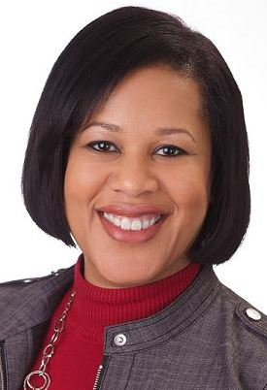
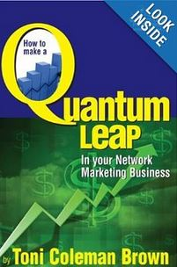
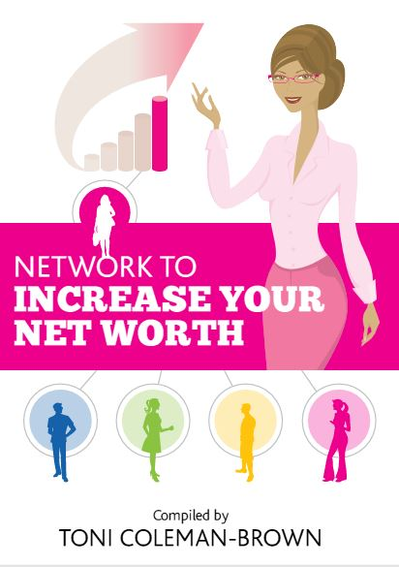
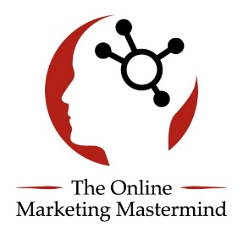
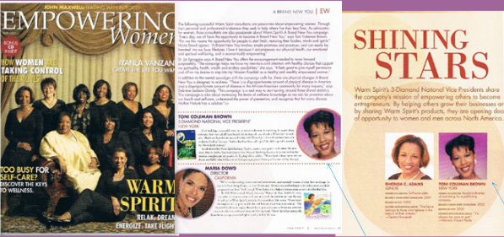
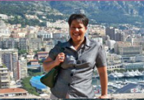
Who Am I?
South of France,
Rome, Florence, Pisa, Tuscany, Naples

Slide 3
Topics Covered for Today
Professional Email Marketing Software
Set Up Professional Email Software
Create Your First List
Lead Capture Pages
Build a high quality Lead capture page
Identify/Create the Lead Magnet
Build a Network Marketing Funnel
Facebook Marketing
Video Ads
Engagement Ads
Boosting Post
Retargeting Pixels
Custom Audiences
Call-to-Action Buttons
Fan Page Timeline Covers
Instagram Marketing
Set Up a Professional Profile
Growing Your Audience
Marketing & Converting Your Audience
Marketing Tools
Youtube Marketing
Getting Videos Noticed
How to Optimize Video
Livestreaming
Video Ads
Monetizing Channels

Slide 4
Goals for the day
Create a Lead Capture Page w/ Click Funnels
Connect the page to a Thank You Page with the 20 Min. Video
Connect your Lead Page to Aweber
Test to Make Sure it Works
Create Facebook Engagement Ad & Post
Teach How to Duplicate on Instagram
Teach How to Duplicate on Youtube

Slide 5
Tools for Today
http://tonicolemanbrown.com/nspire-training-tools/

Slide 6
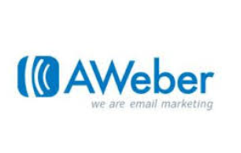
Email Marketing Software
Mailchimp
Get Response
Constant Contact
Take the 30-Day Trial

Slide 7
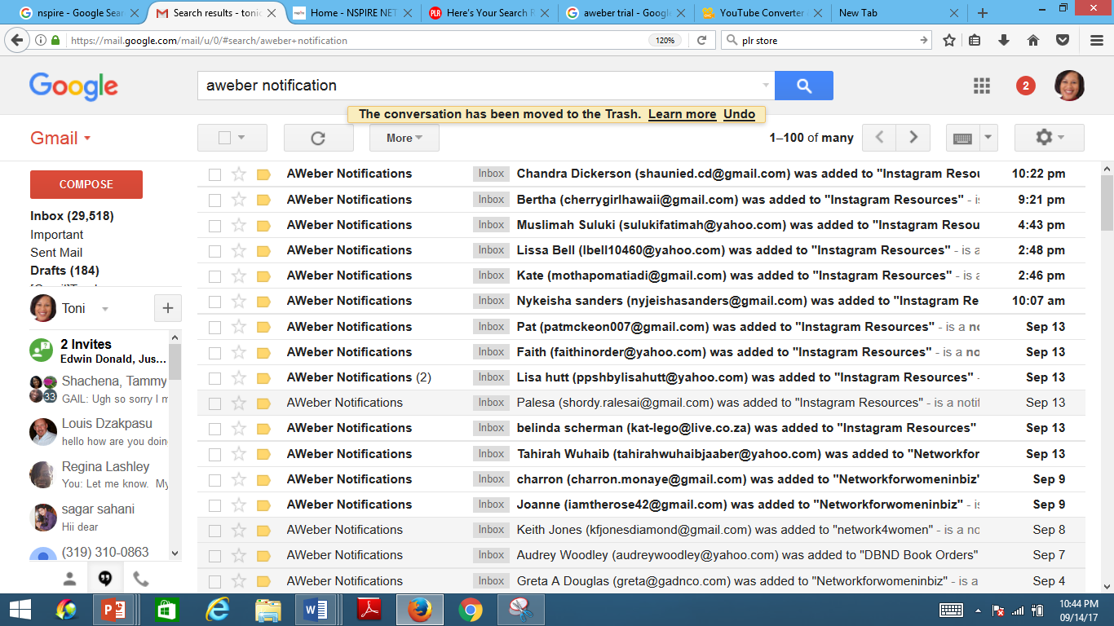
Facebook Drives Traffic to Pages/Websites
Leads
Leads
Leads

Slide 8
Let’s Get Started w/ Aweber

Slide 9
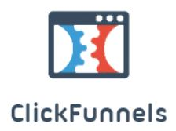
Lead Capture Pages
Leadpages
Optimize Press
My Lead System Pro
BuilderAll (New)
Take the 14-Day Trial

Slide 10
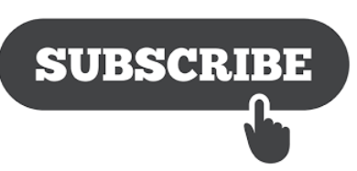
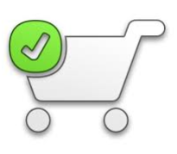
What makes a site/capture page convert…
Catchy Headlines
Not too many choices
Specific Calls-to-Action (e.g. “Get This Now!)
Use the word “I” in your Buy Buttons (e.g. “I Want This Now”)
Not too fancy, Pop-up Boxes
Testimonials
Social Proof via images (Pic of leads Inbox, Sales)
Urgency (Limited Time Offers)
Pricing ends in 5, 7 or 9
Copy of Offer Clearly Solves a Specific Problem

Slide 11
Let’s Get Started w/ ClickFunnels

Slide 12
Click Funnel OptIn Page
Set up account
Integrate w/ Aweber
Choose Optin Funnel
Update Copy – Stop Struggling During that Time of the Month – Discover the Secret That You Need to Know.
Update Thank You Page – Video and Now You Know.

Slide 13
Facebook Advertising

Slide 14
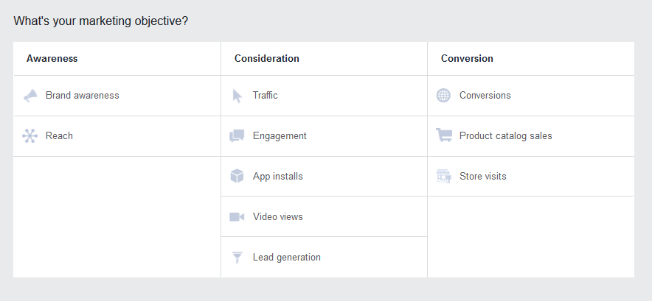
Types of Ad Objectives

Slide 15
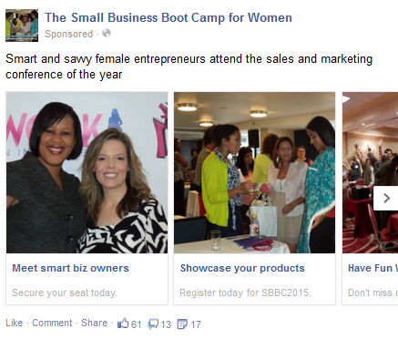
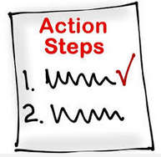
Facebook Ad Carousel
Brainstorm ideas of what type of story you can tell about
your business.
Craft your first Facebook Carousel Ad.

Slide 16
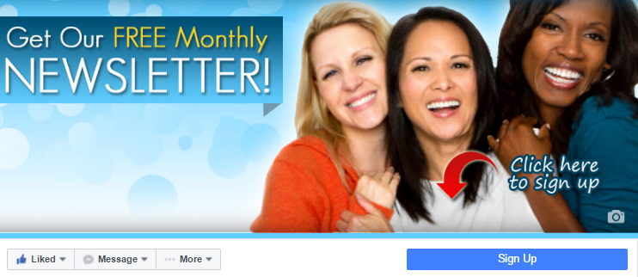
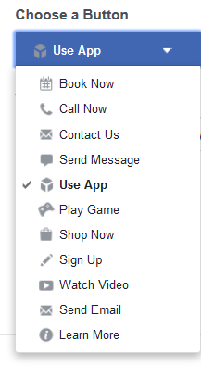
Call to Action Box on Timeline
Create a timeline cover strategy and change it weekly.
Use themes. It could be seasonal.
Change based on your marketing calendar.

Slide 17
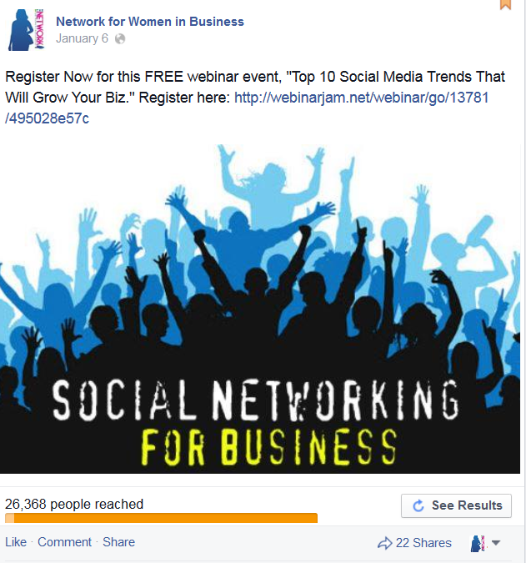
Page Posts Engagement Ad
http://getcrediresponse.com/
As soon as someone comments on your post, they will receive an automatic message from you.

Slide 18
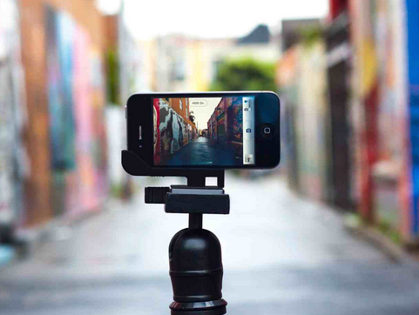
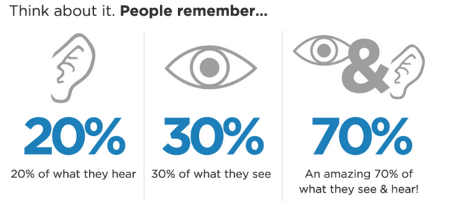
Video is dominating ALL Social Media Platforms

Slide 19
Go Live
You can go live on just about all the major social media platforms:
Snapchat
Instagram
Facebook
Youtube
Periscope
People want to see the real side of brands, which makes this go live feature so popular.
Businesses need to incorporate the Go Live or Snapchat type of strategy into their business.

Slide 20
How to Repurpose & Reuse Live Video
Some of the things you can do with your Live Video
Upload it to Youtube and Build a Youtube channel
Add it to your blog
Send it out via email
Have it transcribed and turn it into books/ebooks
This is just to name a few things that you can do with your video.

Slide 21
Checklist for Crafting Your Ad
What you must do outside of Facebook first…
Make sure you have a great offer (Lead Bait)
Design the right Lead Capture Page
Design Your Thank You Pages
Make sure your Pages are Connect to Email Marketing
Test Everything Out First
Plan your ad (Video, Engagement, etc.)

Slide 22
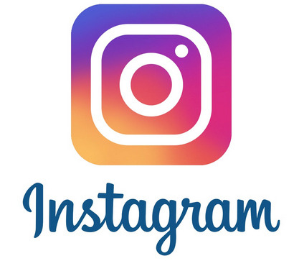
Instagram Marketing 101

Slide 23
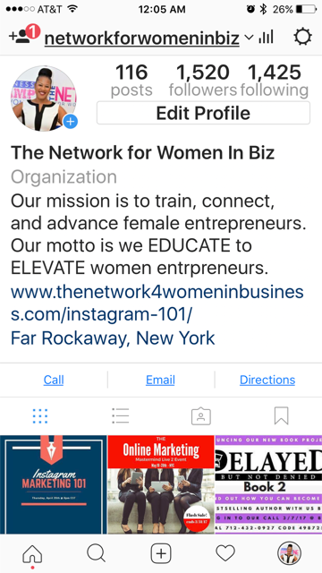
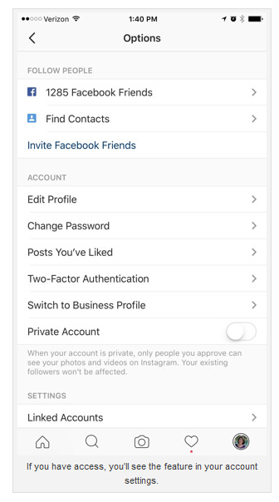
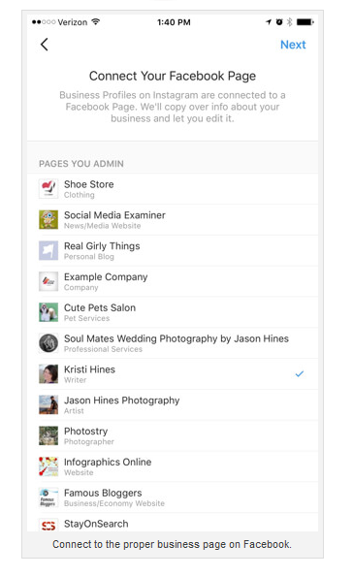
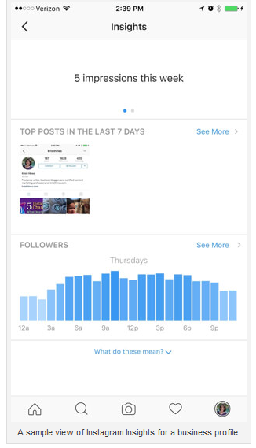
First Things First Setting Up Your Profile

Slide 24
Build a Specific Audience of Followers
Use the Right #Hashtags
Use the Right Filters – Normal
Grab your Competitors Followers
Use Apps (Cleaner & Crowdfire)

Slide 25
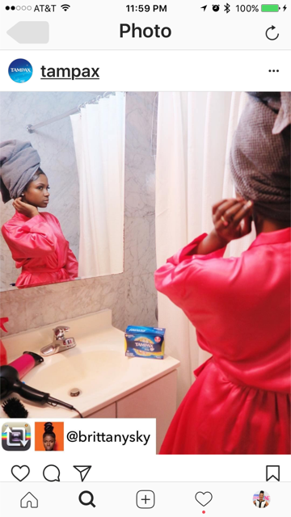
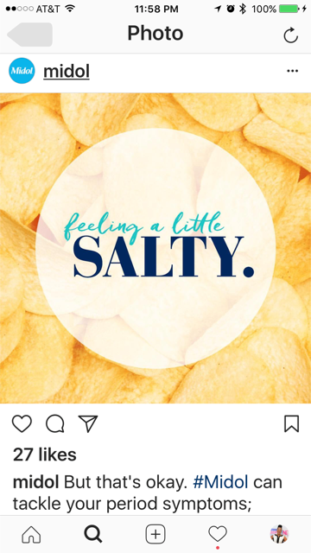
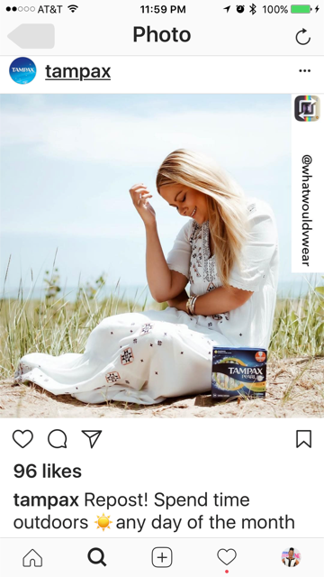
Types of Posts

Slide 26
Instagram Marketing & Conversion Tips
Start with a goal (drive traffic to an offer), a posting strategy and content plan
Use Images/Video (Instagram Live)
Use Brand Specific Hashtags #SBBC2017 or Trending Hashtags
Again Use Emoji’s in your CTA’s(Click the link above)
Connect/Partner with other Influencers
Compelling Storytelling Paid (Sponsored)Ads

Slide 27
I will know I am winning when…
I achieve my stated goals:
# of followers increase
Subscribers
Leads
Downloads
Sales
Increased Engagements, Likes, Comments
My phone rings
Website Traffic Increases

Slide 28
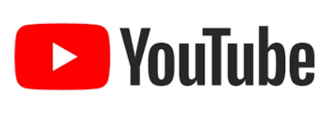
Youtube Marketing

Slide 29
The Not So Quiet Storm
YouTube is like a quiet storm when it comes to Social Media, because no one really thinks about using it to drive traffic or generate leads for their product or service. (Which is why you should…) Plus a lot of the videos are old and outdated. You can look like a hero with new and fresh info.
It’s huge because it’s the only site that can generate RESIDUAL traffic. If you set it up correctly one time, it can generate leads for you again and again and again. It’s a set it and forget it type of marketing with a long useful life.
It’s also worthy to note that Video Traffic converts 800% more than text. (People are Visual). Allows you to build relationships and rapport with viewers. (Because they see you).
It is currently ranked #3 in Alexa. (After Facebook #2 and Google #1)
YouTube is the 2nd Largest Search Engine in the world.
YouTube has 26 million daily users. We also now know that people spend more time on YouTube than they do watching TV.
YouTube videos get more than 2 Billion views per day.
YouTube is also a search engine. A lot of people go to YouTube to watch videos about specific topics of interest.

Slide 30
How to Get Your Videos Noticed
The Key Components of On Page Video Optimization are:
Make sure Your Keyword is in Your File Name.
Using the Keyword in Your Video Title (Preferably in Brackets [ ] )
Properly Setting Up Your Description with your URL (And Add Call to Action in description and On Video e.g. Order Now, Call Me, Go to Website) First and Keywords included in the Description at least 3 to 4 times.
Using your Keywords in your Tags
Playlist, Time Stamps, Description,
TubeBuddy, Livestream
Run Ads & Monetize Channel

